Slide 1

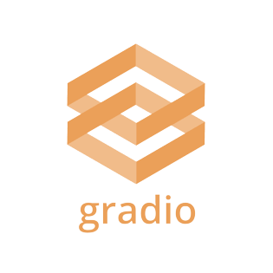

BUILDING INTERACTIVE DEMOS WITH
GRADIO
UMANG CHAUDHRY, DATA SCIENTIST
VANDERBILT DATA SCIENCE INSTITUTE

Slide 2

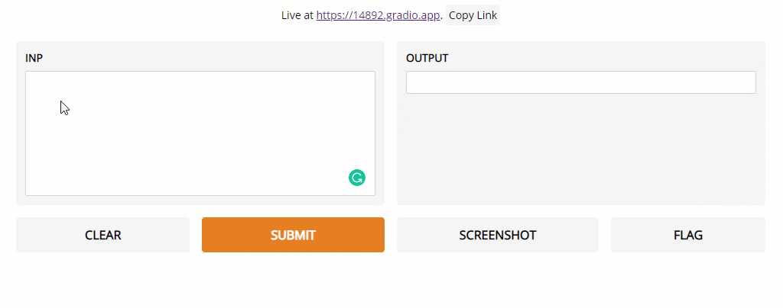


WHY GRADIO?
Platforms like Hugging Face have made building AI and ML models increasingly easy. Gradio helps solve the challenge of effectively testing and sharing these models with stakeholders and the general public
Gradio is a free, open-source Python package which helps you create user interfaces for your models. The additional integration of Gradio with Hugging Face Spaces allows you to effortlessly share your models and Gradio Applications
In the past, creating such web-based applications required an understanding of web development and hosting applications on the web. Gradio eliminates this requirement for simpler applications.

Slide 3




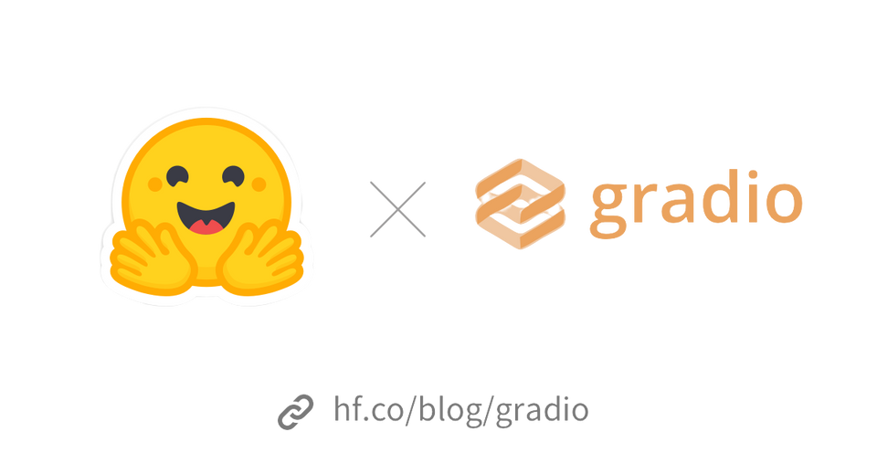

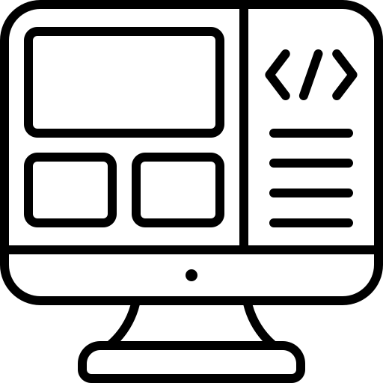


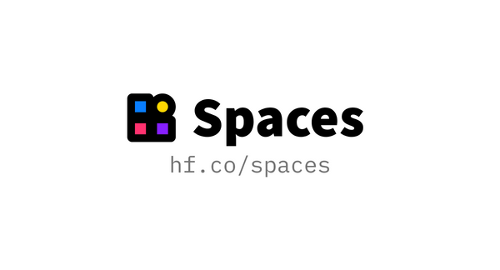
GRADIO AND HUGGING FACE
Gradio is a package for building user-interfaces for a machine learning web applications. Meanwhile, Hugging Face provides the pre-trained models and inference APIs, data processing APIs and hosting services supporting Gradio applications. Essentially, Gradio is like the front-end while Hugging Face runs in the back-end.
Users
Front-End
Back-End
Once tested, these applications can also be permanently hosted on Hugging Face spaces, a free hosting platform that allows you to share your apps.

Slide 4

Gradio Basics
Gradio offers two separate APIs to users: Interface and Blocks
Interface is a high-level abstraction for creating applications
Blocks is a low-level API for designing applications with more flexible layouts and provides greater customizability

Slide 5
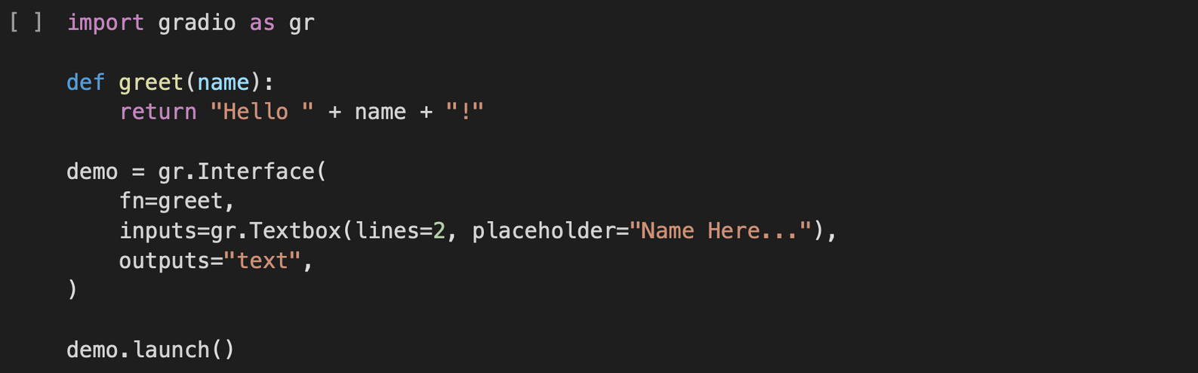
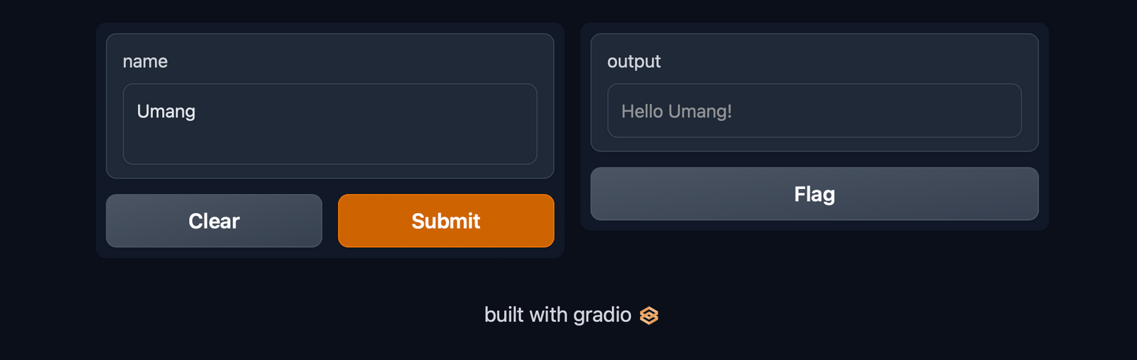
Gradio Basics: The
interface
class

Slide 6
Gradio Basics: The
interface
class
fn - function
The interface class can wrap almost any Python function with a user interface.

Slide 7
Gradio Basics: The
interface
class
inputs: which component(s) to use for the input, e.g. "text" or "image" or "audio"
fn - function
The interface class can wrap almost any Python function with a user interface.

Slide 8
Gradio Basics: The
interface
class
outputs: which component(s) to use for the output, e.g., "text" or "image" "label"
inputs: which component(s) to use for the input, e.g., "text" or "image" or "audio"
fn - function
The interface class can wrap almost any Python function with a user interface.

Slide 9
Gradio Basics: The Blocks API
Blocks takes the work of the Interface class to the next level – while the Interface class provides a good foundation for your applications, it does not offer much customizability.
Blocks allow you to do things like group together related demos, change where UI components appear on the page, handle more complex data flows, change component properties and more – all in Python!

Slide 10
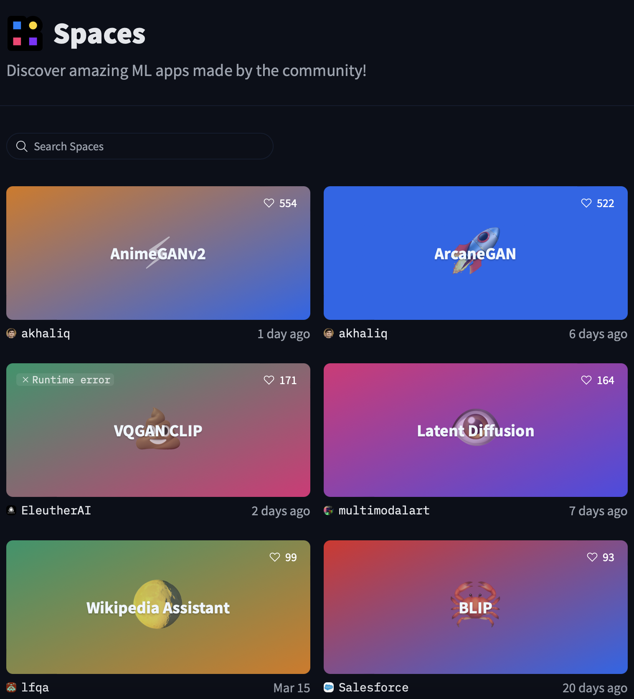




GRADIO APPLICATIONS IN ACTION
Hugging Face Spaces is a great way to explore the various applications that people have developed using Gradio.
Question-Answering
Sketch Recognition
Image Background Removal

